Slide 1


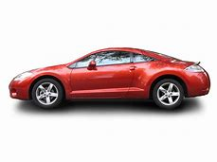
Auto w rld

Slide 2


Property W rld

Slide 3
NO IMAGE
AVAILABLE
Default Image
Buyer Not posting image

Slide 4
NO IMAGE
AVAILABLE
Default Image
Buyer Not posting image

Slide 5

Heavy Machinery
Operator Jobs

Slide 6
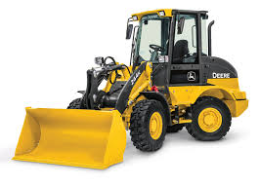

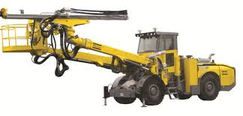
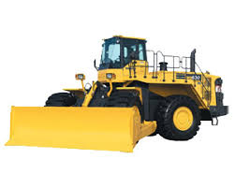
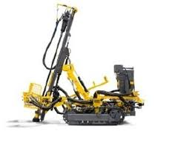
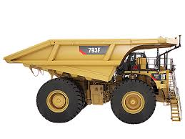
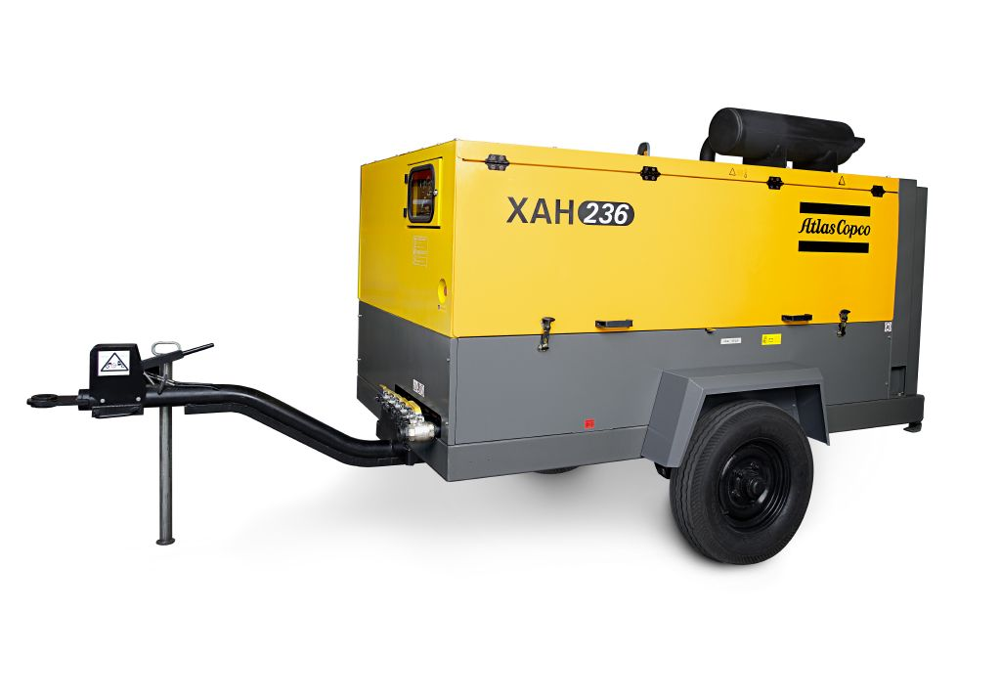
Heavy Machinery
Operator Jobs

Slide 7

Property W o rld

Slide 8
Chemicals w rld

Slide 9


IT w rld

Slide 10


Construction & Hardware
w rld

Slide 11

Consumer w rld

Slide 12
Electrical & Electronic
w rld

Slide 13


Energy & Power W rld

Slide 14

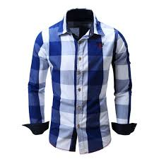

Fashion W rld

Slide 15



Food & Beverages W rld

Slide 16
F
urniture W rld

Slide 17

Gifts & Crafts
W rld

Slide 18

Industrial W rld

Slide 19

Leather W rld

Slide 20
Medical Equipment
W rld

Slide 21
Metal & Mineral
W rld

Slide 22

Office & School
Suppliers W rld

Slide 23
Packaging W rld

Slide 24
Pipes & Tubes
W rld

Slide 25


Plastic W rld

Slide 26
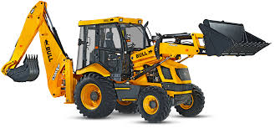

Heavy Equipment W rld

Slide 27
Fabric W rld

Slide 28
Machinery & Plant W rld

Slide 29





Slide 30




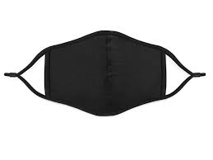

Slide 31
